Slide 1

ECHOCARDIOGRAPHIC ASSESSMENT OF PAH
DR ABHISHEK KUMAR
SR, CARDIOLOGY
MCH KOZHIKODE

Slide 2
Echocardiographic assessment of PAH - OVERVIEW
Definition
Classification and Pathophysiology
Diagnosis
Management
Role of Echo in PAH
  Screening
  Diagnosis
  Evaluation of structure, function and hemodynamics of RV and PA
  Determining the etiology and PH group
  Risk stratification
  Treatment response and monitoring
  Prognostic evaluation

Slide 3
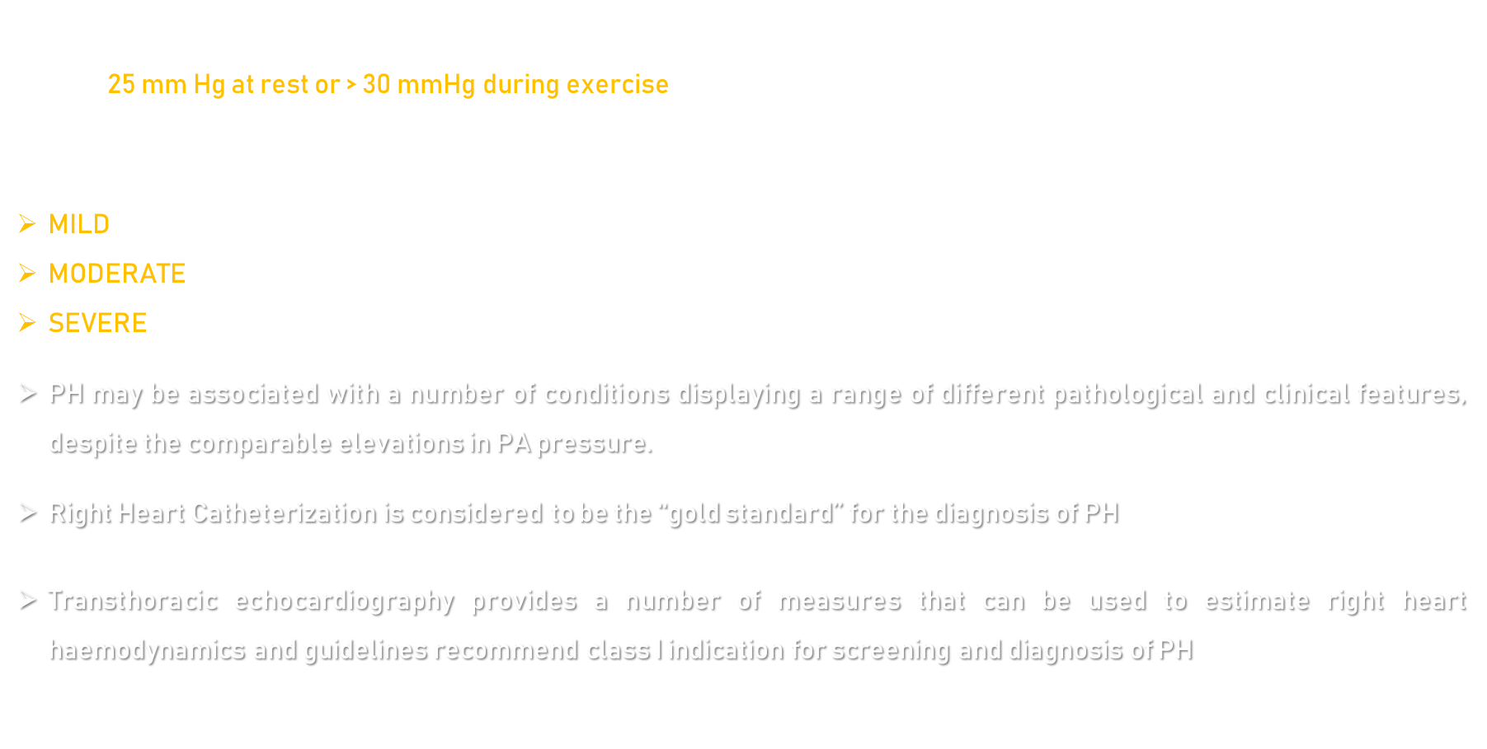
Definition
Pulmonary hypertension is a haemodynamic and pathophysiological condition characterised by Mean PAP greater than 25 mm Hg at rest or > 30 mmHg during exercise and pulmonary vascular resistance > 3 wood units.
Normal mean pulmonary artery pressure is 14 $±$ 3 mm Hg
MILD = 25 – 40 mm Hg
MODERATE = 41-55 mm Hg
SEVERE > 55 mm Hg
PH may be associated with a number of conditions displaying a range of different pathological and clinical features, despite the comparable elevations in PA pressure.
Right Heart Catheterization is considered to be the ‘‘gold standard’’ for the diagnosis of PH
Transthoracic echocardiography provides a number of measures that can be used to estimate right heart haemodynamics and guidelines recommend class I indication for screening and diagnosis of PH

Slide 4
classification

Slide 5
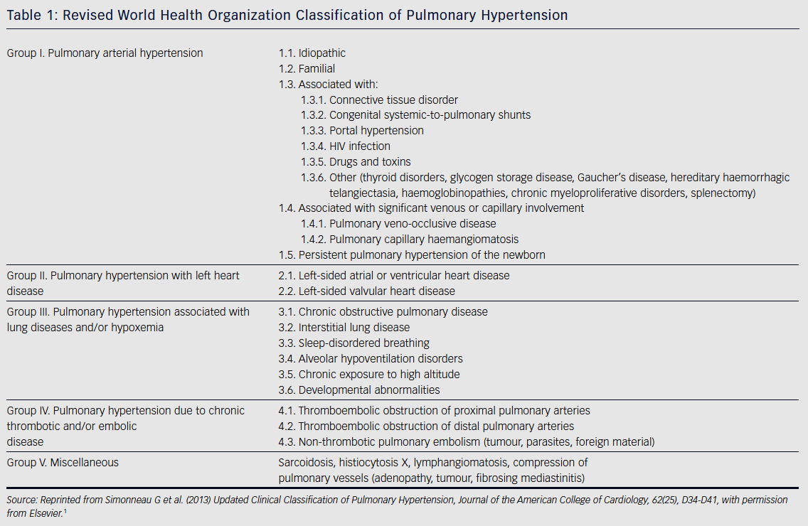

Slide 6
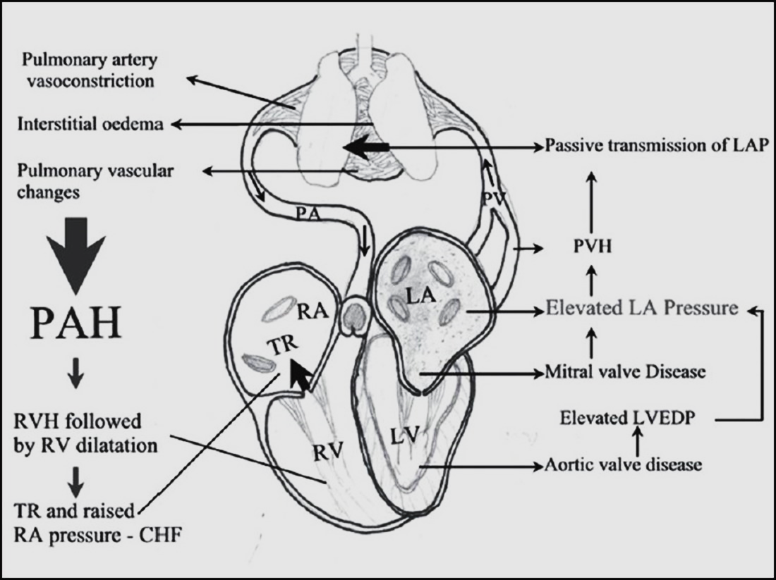
pathophysiology

Slide 7
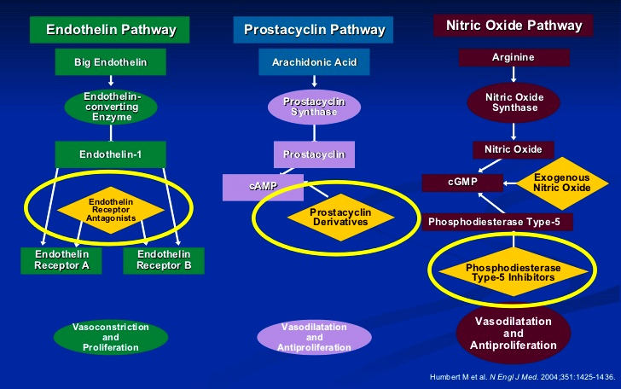
pathophysiology

Slide 8
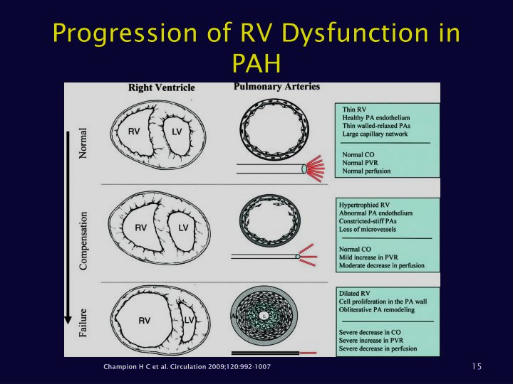
pathophysiology

Slide 9
Clinical features
Generally nonspecific.
Progressive shortness of breath, which is particularly marked during exercise.
Syncopal episodes, presumably related to cardiac arrhythmias
Chest pain as a sign of right-sided cardiac ischemia and is seen late in the course in those who develop cor pulmonale
Abdominal discomfort as a sign of right-sided heart failure with progressive liver congestion.
Features associated with cardiac valvular lesions, predominately on the left side of the heart.

Slide 10
diagnosis

Slide 11
When to suspect and screen for pah?
Family history
  12% prevalence Of positive family history.
  Related genes - BMPR2, ALI, flagellin, MMP9 etc.
  Autosomal dominant, incomplete penetrance, genetic anticipation
Connective tissue disease
  Limited and diffuse scleroderma: 8%-30%
  CREST: up to - 25%
  Systemic lupus erythematosus: 4% - 14%
  Rheumatoid arthritis up to 21%
Congenital Heart Disease
  Reversal of left-to-right shunt
  Ventricular septal defect, patent ductus arteriosus, atrial septal defect, portal hypertension
Deep venous thrombosis/history of pulmonary embolism
  Up to 3-4% of survivors

Slide 12
When to suspect and screen for pah?
HIV
  0.5% (1/200) patients
Sickle cell disease
Haemodialysis patients
Yearly echocardiography is recommended in patients at risk for heritable PAH With CTD, especially patients with scleroderma and SLE
Hence echocardiography should be considered, in patients with PH suggestive symptoms –
  After pulmonary embolism
  With HIV infection
  With portal hypertension
  With prior appetite suppressant use
  With sarcoidosis
  After splenectomy

Slide 13
When to suspect and screen for pah?
Limitations of Echocardiography in PAH
  Experienced technicians and interpreting physicians are essential
  Consistency of skilled technicians/readers
  Images can be limited in some patient populations
  RV, the chamber of highest concern in PAH, is the least emphasized on the "standard“ echocardiography exam
  TR jet may be absent in some patients, thus precluding PASP assessment
  May overestimate or underestimate actual pulmonary arterial pressure

Slide 14
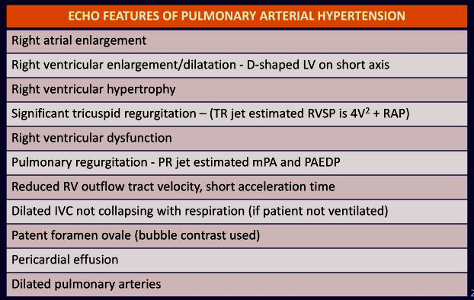

Slide 15
Ra enlargement
4 chamber view
Area trace
DILATED RA = WHEN RA AREA > 18 cm² at end systole
POOR PROGNOSTIC SIGNS IN PHT : RA AREA > 26 cm²

Slide 16
Estimation of pa pressure using echo
PA SYSTOLIC PRESSURE
In the absence of RVOT obstruction RVSP = SYSTOLIC PAP.
RVSP Calculated using the formula (4 x TRV²) + RAP.
Central jet - A4C view / RV focused view.
Eccentric jet - RV inflow view.
Under estimated in RV failure , poor alignment of jet and mild TR.
Over estimated in anaemia and with use of agitated saline contrast

Slide 17
Estimation of pa pressure using echo
PA DIASTOLIC PRESSURE :
4 x PR Ved² + RAP
MEAN PAP :
4 x PR Vmax² + RAP
0.61 x SPAP + 2 mm Hg
TR VTI + RAP
DEBASTANI MAHAN’S equation :
  90 – 0.62 x rvot acc time ( heart rate < 120 msec )
  79 – 0.45 x rvot acc time ( heart rate > 120 msec )

Slide 18
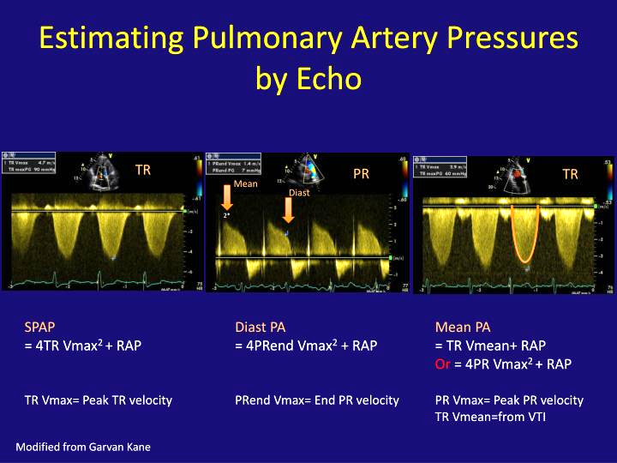
Estimation of pa pressure using echo

Slide 19
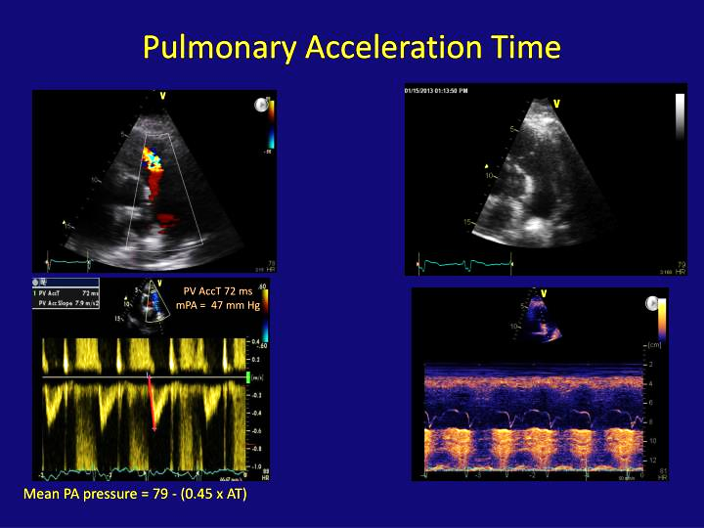
Estimation of pa pressure using echo
RVOT acceleration time
Measurement of RVOT acceleration time
  Parasternal short axis view
  End expiration
  PW doppler just proximal to Pulmonary valve
  Doppler beam aligned with pulmonary forward flow beam
  Sweep speed of 100 .
  Normal RVOT AT > 130 msec
  In PHT RVOT AT < 100 msec

Slide 20
Tr vti
Tricuspid regurgitation velocity time integral
Estimation of pa pressure using echo

Slide 21
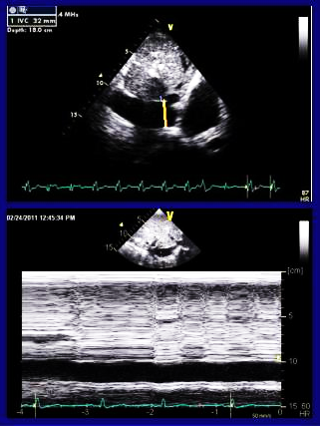
Estimation of pa pressure using echo
RA pressure
RA pressure estimation should not be based upon arbitrary value but rather based upon 2D and doppler study of IVC and hepatic veins
Right atrial pressure : (ASE 2020 guidelines)
  Subcostal view - M mode
  0.5 – 3.0 cm from its opening into RA
  Just before the junction of hepatic vein into IVC.
  End expiration

Slide 22
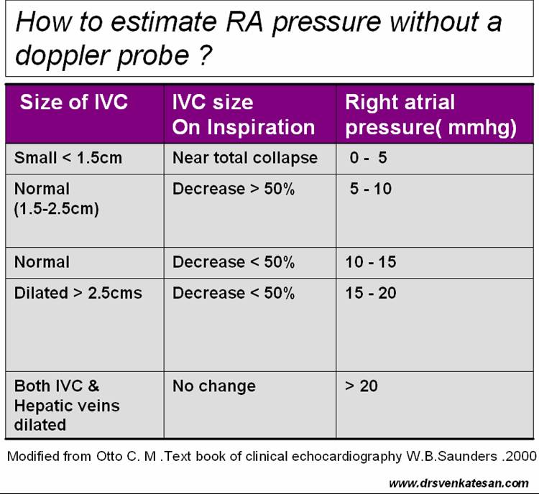
Estimation of pa pressure using echo
RA pressure using ivc
Severity of pulmonary htn
based on rvsp

Slide 23
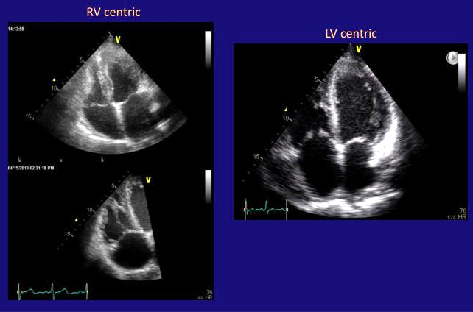
Rv in pah - morphology
First step is obtaining a RV focused image in apical 4 chamber view
RV focused view is obtained by angling the sound beam medially toward the patient’s right shoulder. Slight adjustments in angle and rotation maybe necessary to demonstrate all the structures for this view optimally.

Slide 24
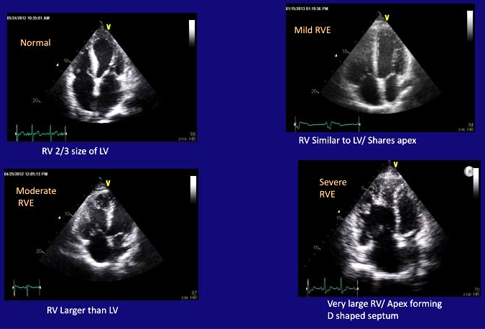
Rv in pah - morphology
Qualitative assessment of RV size
Eyeballing method

Slide 25
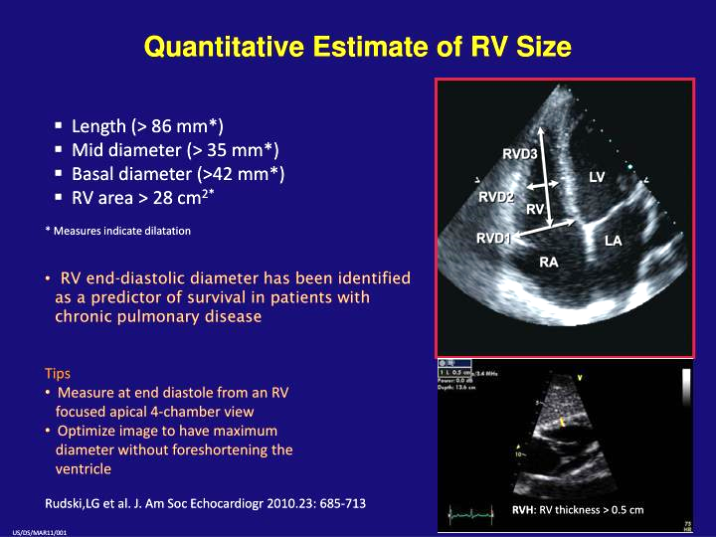
Rv in pah - morphology
Quantitative assessment
Measurement taken at end diastole from RV focused view in apical 4 chamber view
Optimization of image to have maximum diameter without foreshortening
RV Enlargement
  RV D1 > 42 mm or RV D2 > 36 mm
  RV length > 82 mm
  RV Area > 28 cm2
  RVH – RV thickness > 5 mm
RV end diastolic diameter has been identified as a predictor of survival in patients with chronic pulmonary disease

Slide 26
Left ventricle in pah
Normally shape of left ventricle is circular both during systole and diastole.
Increase in RV pressure causes the flattening of IVS towards LV, which gives a D shape of LV.
LV eccentricity index is the ratio of the major axis of the LV parallel to the septum (D2) divided by the minor axis perpendicular to the septum (D1) and is measured in the parasternal short-axis view at the level of the LV papillary muscles in both end diastole and end systole.
D shape LV during diastole – RV Volume overload
D shaped LV during systole – RV pressure overload
D shape during both – combined overload of RV
LV diastolic eccentricity index in diastole > 1.7 has been shown to be prognostic of mortality in patients with idiopathic PAH

Slide 27
Rv in pah - function
RV function evaluation methods –
  Tricuspid annular plane systolic excursion (TAPSE)
  Tricuspid annulus TDI velocities (S’)
  RV MPI (Tei Index)
  RV area fractional shortening
  Dp/dt method
  RV longitudinal strain measurement
  3D RV volume assessment
  3D strain imaging

Slide 28
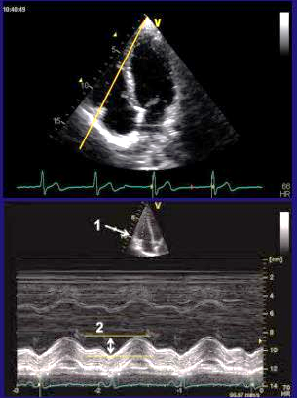
Rv in pah - function
TAPSE
Defined by the total excursion of the tricuspid annulus from its highest position after atrial ascent to the peak descent during ventricular systole
In Apical-4 chamber view, place M-Mode cursor through the lateral tricuspid annulus and measure excursion from end-diastole to end-systole averaged over 3 beats
Simple, reproducible
Represents longitudinal function
Correlates well with radionuclide angiography in determining RV systolic function.
Relatively load and angle dependent.
Normal > 20 mm.
TAPSE < 18 mm has negative prognostic implications

Slide 29
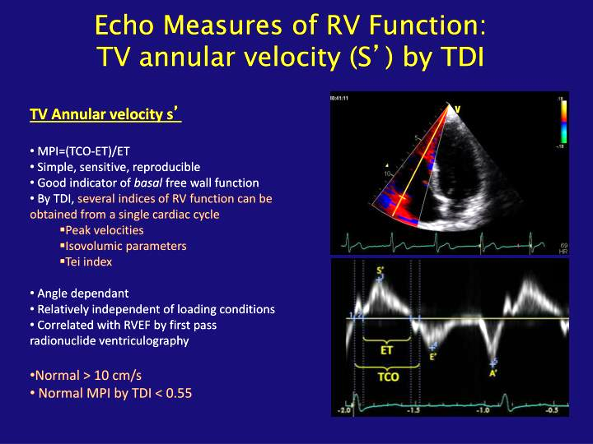
Rv in pah - function
By TDI, several indices of RV function can be obtained from a single cardiac cycle
TV annular velocity (S') by TDI
  Simple, sensitive, reproducible
  Good indicator Of basal free wall function
  Normal > 10 cm/s

Slide 30
Rv in pah - function
Tei index (RV MPI)
The Tei index can be measured either from colour Doppler imaging (apical four-chamber view for the tricuspid inflow pattern or tissue Doppler imaging.
TEI index (RV MPI) = IVCT + IVRT / RVET
Angle dependant
Relatively independent of loading conditions and heart rate
Correlated with RVEF by first pass radionuclide ventriculography
Normal MPI by TDI < 0.55
In patients with idiopathic PAH the index correlates with symptoms and values > 0.88 predict poor survival

Slide 31
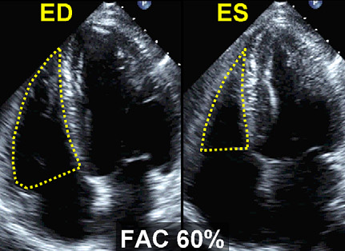
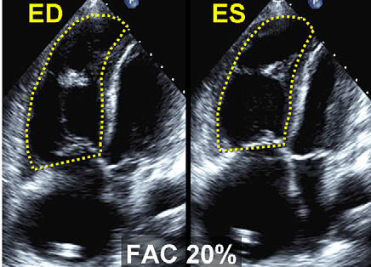
Rv in pah - function
RV FAC (Fractional area change)
RV fractional area change is calculated from end-diastolic area and end-systolic area, measured from the apical four-chamber view.
It is a simple method for the assessment of RV systolic function and has been shown to correlate with prognosis and response to treatment in PH and with survival.
However, limited by difficulties in endocardial definition.
RV fractional area change (%) = (end-diastolic area - end-systolic area)/end-diastolic area
Normal value > 34%

Slide 32
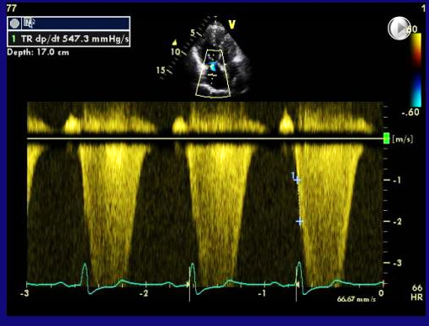
Rv in pah - function
RV Dp/Dt
A simple physiological measure of RV function is the pressure produced during RV systole.
The RV contractility dP/dt can be estimated by using time interval between 1 and 2 m/sec on TR velocity CW spectrum during isovolumetric contraction
A result less than 400 mmHg/sec is an indication for a reduced right ventricular function.

Slide 33
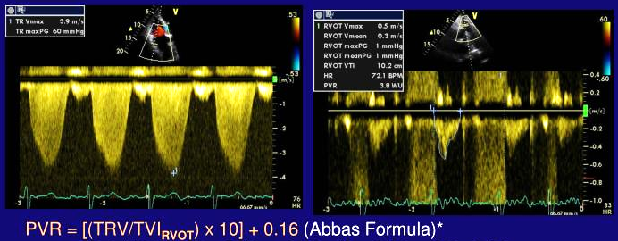
PULMONARY VASCULAR RESISTANCE:
( TR Vmax / RVOT VTI ) x 10 + 0.16
WHEN VALUE < 0.15 → PVR NORMAL.
WHEN VALUE > 0.2 → PVR > 2 WU

Slide 34
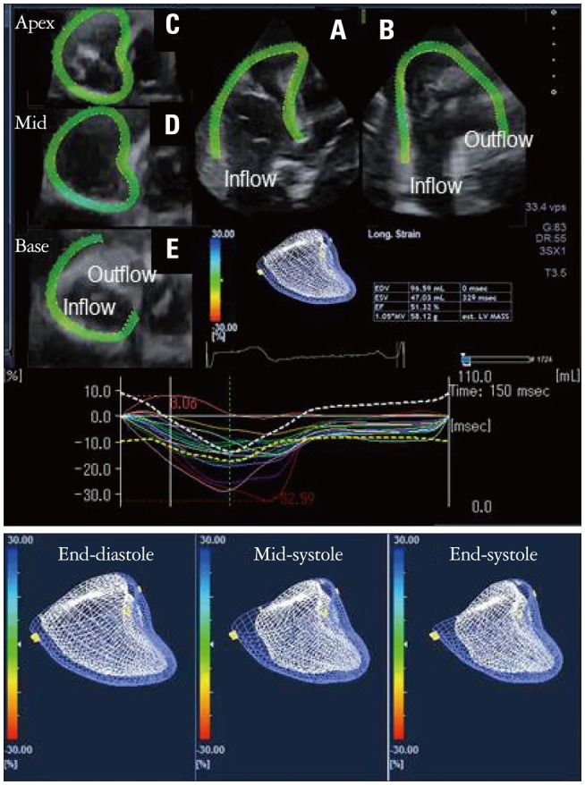
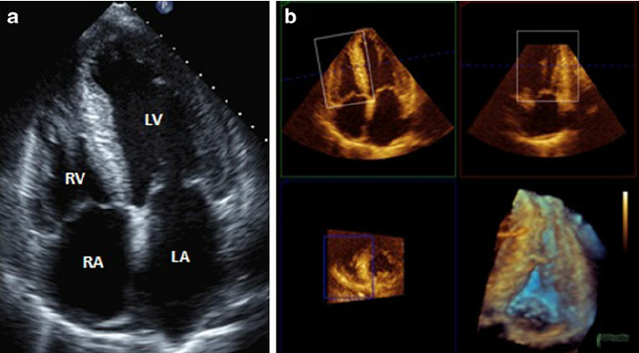
Rv in pah - function
DETERMINATION OF RV MORPHOLOGY AND VOLUME USING 3D IMAGING

Slide 36
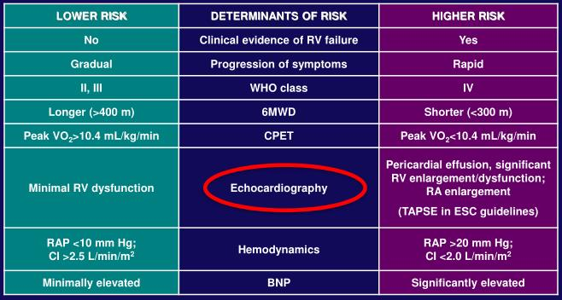
Prognostic and risk determinants in pah

Slide 37
Role of echo in determining types of ph group
Caution is needed in distinguishing PAH from PH related to diastolic abnormalities solely on the basis of
ECHO
Features of "diastolic dysfunction", e.g., delayed relaxation pattern and reduced e' (mitral annular
tissue velocities), may occur in PAH also.
Findings that Increase the Clinical Suspicion of PVH – Age (elderly), Female gender, Obesity, Systemic HTN (particularly if not optimally controlled), Diabetes mellitus, Coronary artery disease, Obstructive sleep apnoea and Atrial fibrillation.
ECG findings: Lack of right axis deviation, Lack of right atrial enlargement or RVH, Evidence of left atrial enlargement, Evidence of left ventricular hypertrophy
Chest X-ray findings: Pulmonary vascular congestion/ Kerley B lines, Pulmonary edema, Pleural effusion

Slide 38
Role of echo in determining types of ph group
Left sided origin of PH | Right-sided Origin of PH
2-D Echocardiography
LVH, LAE | Normal LV, LA size
Normal RV size | RV dilatation
No interventricular septal bowing | Right to left interventricular septal bowing
Atrial septum neutral or bowed to right | Atrial septum bowed to left
Usually normal RV function | Usually RV dysfunction+
No pericardial effusion | Mild to moderate pericardial effusion
Moderate to severe mitral valve disease | No or minimal mitral valve disease
Moderate to severe LV D/D | Normal or mild LV D/D
Absence of notched pattern in RVOT doppler signal | Notched doppler signal in RVOT

Slide 39
Treatment
PAH Treatment Goals
  Improve quality of life and survival
  Improve to FC I or II
  Improve 6MWD to ≥380 m
  Improve hemodynamic
  Alleviate symptoms

Slide 40
Treatment
Endothelin Receptor Antagonists
  Bosentan, Ambrisentan, Macitentan
Phosphodiesterase Inhibitors
  Sildenafil, Tadalafil
Soluble GC Stimulator
  Riociguat
Prostanoids
  Epoprostenol (IV), Treprostinil (IV, SQ, inhaled, oral), Iloprost (inhaled), Selexipeg (oral)
Calcium Channel Blockers
  Used for patients with IPAH who respond to acute vasodilatora testing at the time of cardiac catheterization.
Combination therapy

Slide 41
Echocardiographic assessment of PAH – Conclusion
PAH is a rare disease associated with very high mortality if untreated.
PAH is a diagnosis of exclusion and diagnosis requires a comprehensive cardiopulmonary evaluation as well as a right heart catheterization.
Detailed echocardiographic assessment of patients with PH allows useful diagnostic information to be collected.
It can also be used to assess severity of right ventricular dysfunction, providing prognostic information and a noninvasive means of following disease progression or response to therapy.

Slide 42
Echocardiographic assessment of PAH – Conclusion
  Size and surface areas of both atria.
  Left-ventricular size and systolic /diastolic function
  Any valvular abnormality (MS, MR, AS etc..), pericardial effusion or intracardiac shunt
  Subjective "eyeball" assessment of RV function ( good vs mild, moderate or severe RV dysfunction)
  Percent Fractional Area Change (% FAC)
  Tricuspid Annular Plane Systolic Excursion (TAPSE)
  Eccentricity Index / D-shaping of the IVS
  TDI systolic velocity Of the RV lateral annulus (S’)
  RV Myocardial Performance Index (MPI) or Tei index
  Pulmonary Artery Acceleration Time (PAAT) and presence/ timing of Notching
  Pulmonary artery pressures (Systolic, Diastolic, Mean)
  RA pressure ( IVC size and collapse)
  Contrast study findings (CHD, PFO) (if done)
  3D echocardiography findings (if done)

Slide 43

THANK YOU

